Slide 1
Adversarial Training
Presenter: Ahmad Khan
Textbook Seminar

Slide 2
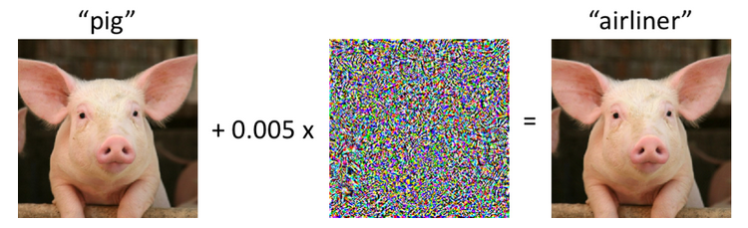
Introduction
Definition: Adversarial Training is a defense technique where a neural network is explicitly trained on adversarial examples (inputs with intentionally crafted noise) to make it resilient against attacks.
Why Standard Training Fails: Standard empirical risk minimization (ERM) only optimizes for clean data, leaving the decision boundary vulnerable to tiny, imperceptible perturbations.
Objective: Trade a small fraction of clean accuracy to gain substantial security and robustness against worst-case inputs.

Slide 3
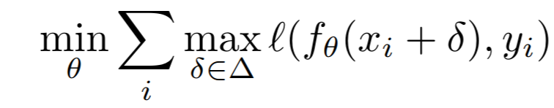
Min-Max Optimization
The core learning objective is formulated as a two-player zero-sum game.
Two Opposing Goals:
Inner Maximization (max_{δ∈Δ}): Adversary searches for noise δ that maximizes model loss.
Outer Minimization (min_{θ}): Defender adjusts weights θ to minimize worst-case loss.

Slide 4
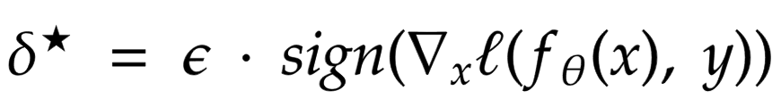
Fast Gradient Sign Method
Concept: Takes a single step in the direction of the loss gradient to maximize loss.
Why sign(): Moving along the sign vector steps directly to the corners of the ℓ∞ bounding box, maximizing step size.
Pro: Very fast to compute.
Con: Provides a coarse linear approximation that often fails against stronger multi-step attacks

Slide 5
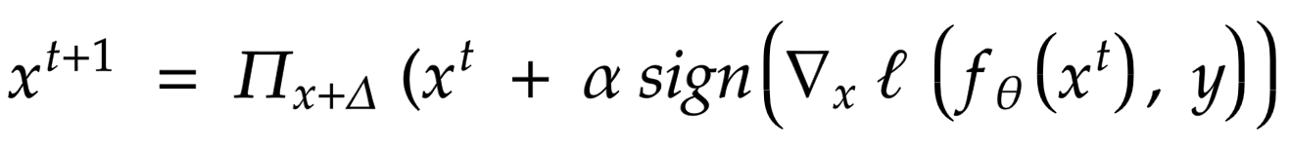
Projected Gradient Descent
Concept: An iterative multi-step version of FGSM that explores the non-linear loss landscape
Key Components:
Step Size α: Takes smaller steps than ε.
Projection Π: Clips values back into [-ε, ε] if an iteration steps outside the threat model.
Random Restarts: Starts from multiple random points inside x + Δ to avoid getting stuck in local traps.

Slide 6
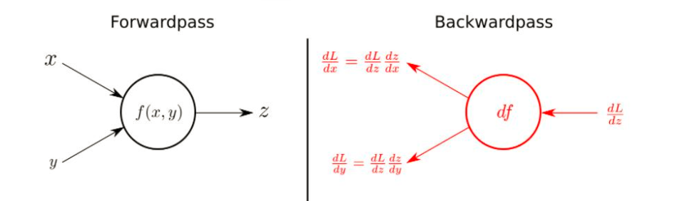
Why Attack Crafting Requires Backpropagation
Forward Pass: Input → Model → Loss
Problem: Tells you how wrong the model is, but gives zero direction on how to tweak pixels.
Backward Pass: Computes exact partial derivatives using the chain rule.
Dual Role of Backpropagation:
∇_{θ}Loss: Gradient w.r.t. parameters → Update weights to decrease loss.
∇_{x} Loss: Gradient w.r.t. input pixels → Update noise to increase loss.

Slide 7
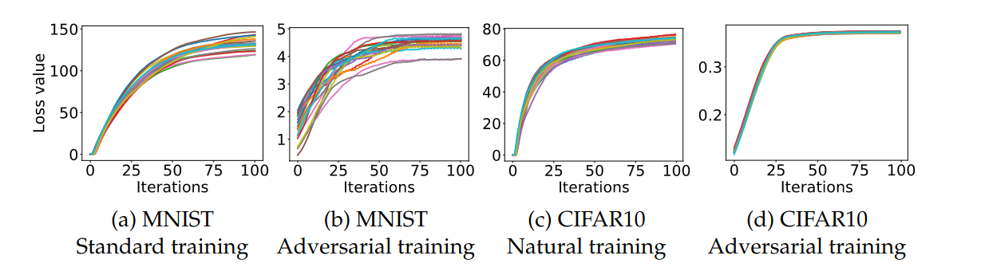
Non-Concavity and Universal Adversaries
Challenge: Neural network loss surfaces are highly non-concave; finding global maxima is theoretically hard.
Empirical Discovery:
Local maxima found by PGD have remarkably consistent, high loss values across random restarts.
The loss values of local maxima are concentrated in a narrow band.
Takeaway: PGD acts as a "universal first-order adversary." If a model is defended against PGD, it inherits resistance against all first-order attacks.

Slide 8
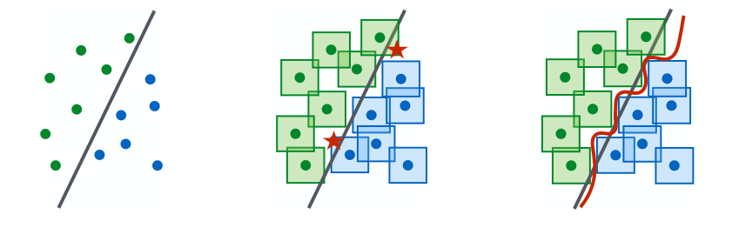
Why Capacity is Essential for Robustness
Robust training requires separating whole ℓ∞-balls around data points, not just individual points.
Key Insights:
Increased Demand: Decision boundaries must be significantly more complex to encapsulate perturbation balls.
Capacity Limit: Small networks (low parameter count) suffer severe capacity bottlenecks and cannot achieve both clean and robust accuracy.
Solution: Scaling up network width (e.g., Wide-ResNet) dramatically improves robust performance.

Slide 9
High Cost of Standard Robust Training
The PGD-7 Math:
7 Backward passes to generate the 7-step PGD attack.
1 Backward pass to compute ∇_{θ} and update model weights.
Total: 8 Backward passes per training iteration (≈ 8 × slowdown over standard training).
Impact: Training standard models on datasets like CIFAR-10 or ImageNet takes days or weeks.
Question: Can we get PGD-level robustness without paying the N × computational penalty?

Slide 10
"Free" Adversarial Training
Breakthrough Concept: Simultaneous updates!
Instead of wasting backward passes strictly crafting noise, update both pixels δ and weights θ in the exact same step.
Mechanics:
Replays each minibatch m times consecutively.
Backward pass calculates ∇_{x} Loss and ∇_{θ} Loss simultaneously.
Updates δ to make attack harder and updates θ to make model smarter in 1 pass.
To balance compute time, total training epochs are reduced by m.

Slide 11
Fast-FGSM
Revisiting Single-Step Training:
Single-step FGSM was previously thought to be ineffective.
Fix - Random Initialization:
Initialize noise randomly within the ball before taking an FGSM step: δ∼ Uniform (-ε, ε).
Prevents perturbations from over-fitting to zero-centered boundaries.
Result: Achieves robust accuracy equal to 7-step PGD while running as fast as standard single-step training.

Slide 12
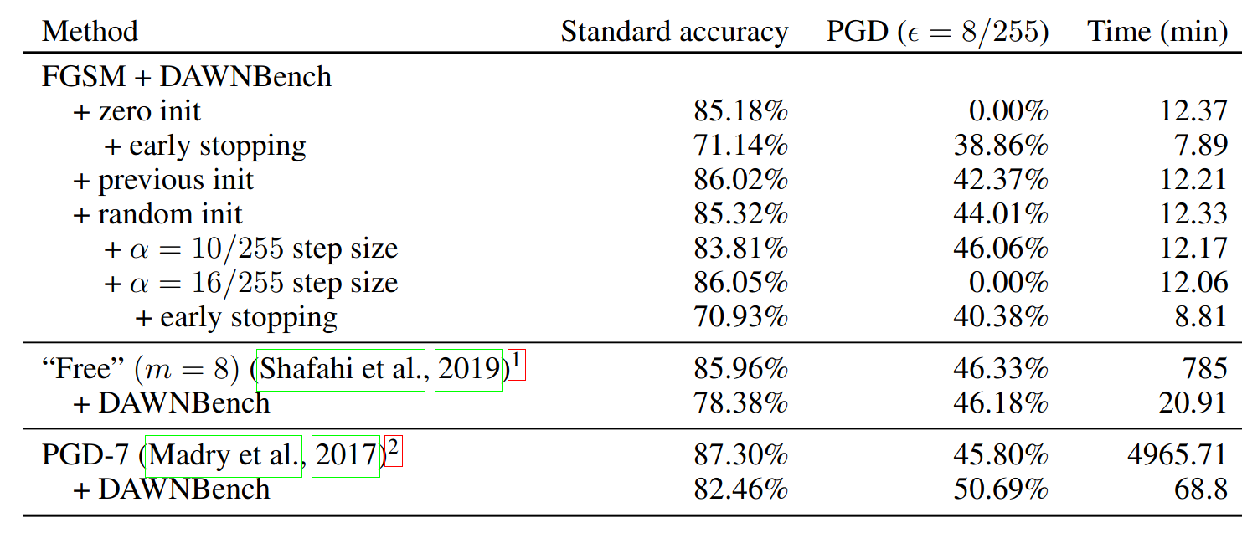
Cost Comparison

Slide 13
Catastrophic Overfitting
Catastrophic Overfitting: A sudden breakdown during Fast-FGSM training where robust accuracy against multi-step PGD crashes to 0% in a single epoch.
Causes:
Step size α chosen too large (e.g., α = 2ε).
Lack of random noise initialization.
Prevention:
Use optimal step sizes (α ≈ 1.25ε).
Monitor robust accuracy on a small validation batch evaluated with multi-step PGD.

Slide 14
Conclusion
Mathematical Core: Adversarial training is modeled as a Min-Max optimization problem balancing inner maximization (attack) and outer minimization (defense).
Capacity Requirement: High network capacity is mandatory to accommodate complex, robust decision boundaries.
Optimization Evolution:
PGD: Strongest benchmark, but computationally expensive (N × backward passes).
Free: Recycles backward passes to update parameters and perturbations concurrently.
Fast-FGSM: Restores single-step training efficiency via random initialization.

Slide 15
ANY QUESTION?

Slide 16
THANK YOU :)

